Slide 1
Lesson 5
CAN Log Analysis
Date

Slide 2
Analyze CAN data in Practical
■Raw CAN frame is NOT human-readable.
In order to understand, we need to decode the CAN frames into scaled engineering values – physical values (km/h, °C, True-False,…)

Slide 3
Analyze CAN data in Practical
■Case Study to be introduced:
  CAN log served for purpose of checking data transferred between ECU-ECU
  CAN log served for diagnostic data (OBD-UDS) between User-ECU or ECU-ECU

Slide 4
Analyze CAN data in Practical (Case Study 1)
■Case Study 1: CAN log served for purpose of checking data transferred between ECU-ECU
What we need:
CAN log file (There might be various format .asc, .txt, .mf4,…)
  ➡Target to analyze
CAN Database (Can be .dbc file or layout explained in Excel)
  ➡To understand the data layout (position and meaning) in data frame
Tool to analyze (not mandatory)

Slide 5
Analyze CAN data in Practical (Case Study 1)
■Analysis Basis:
Most Significant BIT in 1 BYTE (= 8bits) always to the LEFT
Least Significant BIT in 1 BYTE (= 8bits) always to the RIGHT
HEX
9 C
BIN
1001 1100
msb
Most Significant Bit
lsb
Most Significant Bit

Slide 6
Analyze CAN data in Practical (Case Study 1)
■Analysis Basis:
Little Endian (Intel format):
Least Significant BYTE → Most Significant BYTE
  Least Significant Byte will be transferred first
Big Endian (Motorola format):
Most Significant BYTE → Least Significant BYTE
  Most Significant Byte will be transferred first
Data:
9C 8B 7A 60
MSB
Most Significant Byte
LSB
Least Significant Byte
Order | Content
0 | 60
1 | 7A
2 | 8B
3 | 9C
Order | Content
0 | 9C
1 | 8B
2 | 7A
3 | 60

Slide 7
Analyze CAN data in Practical (Case Study 1)
①Example: Data frame with the purpose of providing information (Intel format)
Raw data (Tool view)
Raw data (.asc view)
Raw data (Removed unnecessary information)
ID | DLC | Data Bytes
0x6B | 0x05 | 69 3B A0 06 00

Slide 8
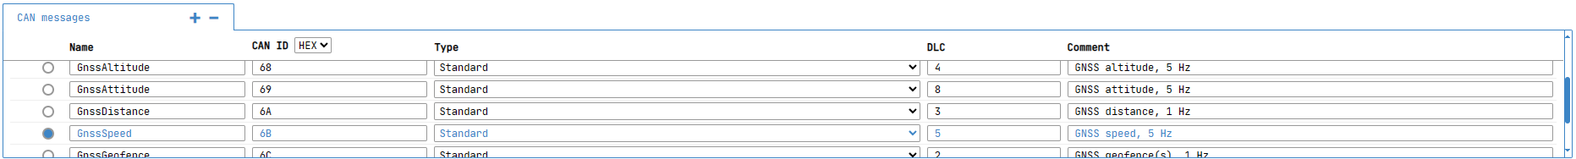
Analyze CAN data in Practical (Case Study 1)
①Example: Data frame with the purpose of providing information (Intel format)
Get information about related CAN ID in CAN database:
8
Standard CAN signals ID 0x6B (GnssSpeed)
Name | Type | Order | Mode | Start | Length | Factor | Offset | Min | Max | Unit | Comment
SpeedValid | Unsigned | Intel | Signal | 0 | 1 | 1 | 0 | 0 | 0 |  | Speed valid
Speed | Unsigned | Intel | Signal | 1 | 20 | 0.001 | 0 | 0 | 1048.575 | m/s | Speed m/s
Speed Accuracy | Unsigned | Intel | Signal | 21 | 19 | 0.001 | 0 | 0 | 524.287 | m/s | Speed accuracy

Slide 9
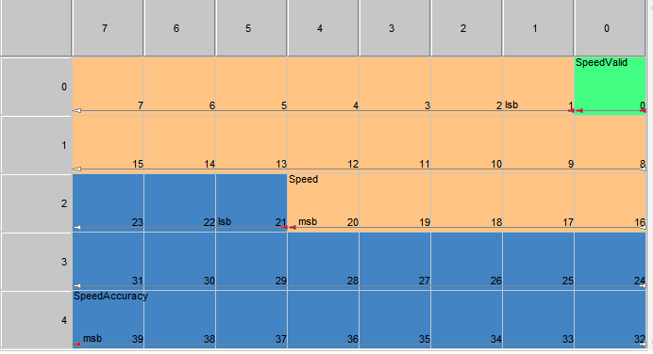
Analyze CAN data in Practical (Case Study 1)
①Example: Data frame with the purpose of providing information (Intel format)
Raw data (Removed unnecessary information)
ID | DLC | Data Bytes
0x6B | 0x05 | 69 3B A0 06 00
Bit Order:
7 6 5 4 3 2 1 0
Hex to Binary:
01101001 00111011 10100000 00000110 00000000
This is Intel Structure
➡Little Endian Order
➡Byte Order: Least Significant BYTE → Most Significant BYTE
15 14 13 12 11 10 9 8
Bit Order:
…
Name | Start | Length | Comment | Raw Data
SpeedValid | 0 | 1 | Speed valid
Speed | 1 | 20 | Speed m/s
Speed Accuracy | 21 | 19 | Speed accuracy

Slide 10
Analyze CAN data in Practical (Case Study 1)
①Example: Data frame with the purpose of providing information (Intel format)
Raw data (Removed unnecessary information)
ID | DLC | Data Bytes
0x6B | 0x05 | 69 3B A0 06 00
Hex to Binary:
01101001 00111011 10100000 00000110 00000000
Name | Start | Length | Comment | Raw Data
SpeedValid | 0 | 1 | Speed valid | 1
Speed | 1 | 20 | Speed m/s
Speed Accuracy | 21 | 19 | Speed accuracy

Slide 11
Analyze CAN data in Practical (Case Study 1)
①Example: Data frame with the purpose of providing information (Intel format)
Raw data (Removed unnecessary information)
ID | DLC | Data Bytes
0x6B | 0x05 | 69 3B A0 06 00
Hex to Binary:
01101001 00111011 10100000 00000110 00000000
Name | Start | Length | Comment | Raw Data
SpeedValid | 0 | 1 | Speed valid | 1
Speed | 1 | 20 | Speed m/s | 【00000】【00111011】【0110100】
Speed Accuracy | 21 | 19 | Speed accuracy

Slide 12
Analyze CAN data in Practical (Case Study 1)
①Example: Data frame with the purpose of providing information (Intel format)
Raw data (Removed unnecessary information)
ID | DLC | Data Bytes
0x6B | 0x05 | 69 3B A0 06 00
Hex to Binary:
01101001 00111011 10100000 00000110 00000000
Name | Start | Length | Comment | Raw Data
SpeedValid | 0 | 1 | Speed valid | 1
Speed | 1 | 20 | Speed m/s | 【00000】【00111011】【0110100】
Speed Accuracy | 21 | 19 | Speed accuracy | 【00000000】【00000110】【101】

Slide 13
Analyze CAN data in Practical (Case Study 1)
①Example: Data frame with the purpose of providing information (Intel format)
Raw data (Removed unnecessary information)
ID | DLC | Data Bytes
0x6B | 0x05 | 69 3B A0 06 00
Apply Scaling to the raw data:
Physical Value = Offset + scale * raw_value_decimal
Name | Start | Length | Comment | Raw Data | Factor | Offset | Min | Max | Unit | Physical Value
SpeedValid | 0 | 1 | Speed valid | 1 = 1 (Dec) | 1 | 0 | 0 | 0 |  | 1
Speed | 1 | 20 | Speed m/s | 00000001110110110100 = 7604 (Dec) | 0.001 | 0 | 0 | 1048.575 | m/s | 7.604 m/s
Speed Accuracy | 21 | 19 | Speed accuracy | 0000000000000110101 = 53 (Dec) | 0.001 | 0 | 0 | 524.287 | m/s | 0.053 m/s

Slide 14
Analyze CAN data in Practical (Case Study 1)
②Example: Data frame with the purpose of providing information (Motorola format)
Raw data (tool view)
Raw data (.asc view)
Raw data (Removed unnecessary information)
ID | DLC | Data Bytes
0x5D7 | 0x07 | 0F B5 01 3D 69 50 FE

Slide 15
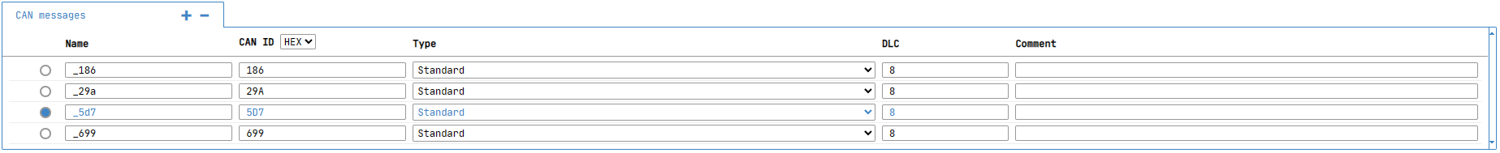
Analyze CAN data in Practical (Case Study 1)
②Example: Data frame with the purpose of providing information (Motorola format)
Get information about related CAN ID in CAN database:
15
Standard CAN signals ID 0x5D7
Name | Type | Order | Mode | Start | Length | Factor | Offset | Min | Max | Unit | Comment
Speed | Unsigned | Motorola | Signal | 7 | 16 | 0.01 | 0 | 0 | 0 | Km/h
Odometer | Unsigned | Motorola | Signal | 31 | 27 | 1 | 0 | 0 | 0 | km

Slide 16
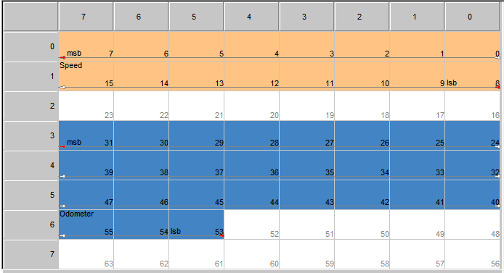
Analyze CAN data in Practical (Case Study 1)
②Example: Data frame with the purpose of providing information (Motorola format)
Raw data (Removed unnecessary information)
ID | DLC | Data Bytes
0x5D7 | 0x07 | 0F B5 01 3D 69 50 FE
Bit Order:
7 6 5 4 3 2 1 0
Hex to Binary:
00001111 10110101 00000001 00111101 01101001 01010000 11111110
This is Motorola Structure
➡Big Endian Order
➡Byte Order: Most Significant BYTE → Least Significant BYTE
15 14 13 12 11 10 9 8
Bit Order:
…
Name | Start | Length | Comment | Raw Data
Speed | 7 | 16
Odometer | 31 | 27

Slide 17
Analyze CAN data in Practical (Case Study 1)
②Example: Data frame with the purpose of providing information (Motorola format)
Raw data (Removed unnecessary information)
ID | DLC | Data Bytes
0x5D7 | 0x07 | 0F B5 01 3D 69 50 FE
Hex to Binary:
00001111 10110101 00000001 00111101 01101001 01010000 11111110
Name | Start | Length | Comment | Raw Data
Speed | 7 | 16 |  | 【00001111】【10110101】
Odometer | 31 | 27

Slide 18
Analyze CAN data in Practical (Case Study 1)
②Example: Data frame with the purpose of providing information (Motorola format)
Raw data (Removed unnecessary information)
ID | DLC | Data Bytes
0x5D7 | 0x07 | 0F B5 01 3D 69 50 FE
Hex to Binary:
00001111 10110101 00000001 00111101 01101001 01010000 11111110
Name | Start | Length | Comment | Raw Data
Speed | 7 | 16 |  | 【00001111】【10110101】
Odometer | 31 | 27 |  | 【00111101】【01101001】【01010000】【111】

Slide 19
Analyze CAN data in Practical (Case Study 1)
②Example: Data frame with the purpose of providing information (Motorola format)
Raw data (Removed unnecessary information)
ID | DLC | Data Bytes
0x5D7 | 0x07 | 0F B5 01 3D 69 50 FE
Apply Scaling to the raw data:
Physical Value = Offset + scale * raw_value_decimal
Name | Start | Length | Comment | Raw Data | Factor | Offset | Min | Max | Unit | Physical Value
Speed | 7 | 16 |  | 0000111110110101 = 4021 (Dec) | 0.01 | 0 | 0 | 0 | Km/h | 40.21 km/h
Odometer | 31 | 27 |  | 001111010110100101010000111 = 32197255 (Dec) | 1 | 0 | 0 | 0 | km | 32197255 km

Slide 20
Analyze CAN data in Practical (Case Study 2)
■Case Study 2: CAN log served for Diagnostic data (OBD-UDS) between User-ECU(via Diagnostic tool) or ECU-ECU
What we need:
CAN log file (There might be various format .asc, .txt, .mf4,…)
  ➡Target to analyze
CAN based higher layer protocol format understanding (UDS, CCP/XCP,…)
CAN Database (not mandatory)
Tool to analyze (not mandatory)

Slide 21
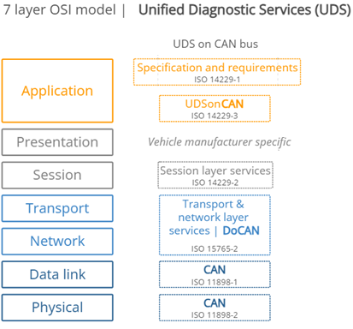
Analyze CAN data in Practical (Case Study 2)
■What are CAN based higher layer protocols?
Unified Diagnostic Services (UDS)
is a communication protocol, which is specified in the ISO 14229, used in automotive Electronic Control Units (ECUs) to enable
On Board Diagnostic(OBD) / Diagnostic on CAN(DoCAN)
is a term referring to a vehicle's self-diagnostic and reporting capability. A primary benefit of this is that OBD systems give the vehicle owner or repair technician access to the status of the various vehicle sub-systems.
CAN Protocol

Slide 22

Analyze CAN data in Practical (Case Study 2)
■What are CAN based higher layer protocols?
UDS frame format:
#1 Protocol Control Information (PCI)
  PCI field is not related to the UDS message, but it is required for diagnostic UDS requests made on CAN bus. the PCI field can be 1-3 bytes long and contains information related to the transmission of messages that do not fit within a single CAN frame.
#2 Service ID (SID)
  Service Identifier (SID) field represent for the service which is utilized by sender.
#3 Sub Function Byte
  The sub function byte is used in some UDS request frames to describe more detail about the action of service. Not all Services have Sub Function Byte.
#4 Request Data Parameters
  In most UDS request services, various types of request data parameters are used to provide further configuration of a request beyond the SID and optional sub function byte. But not all Services have Data parameters field.

Slide 23
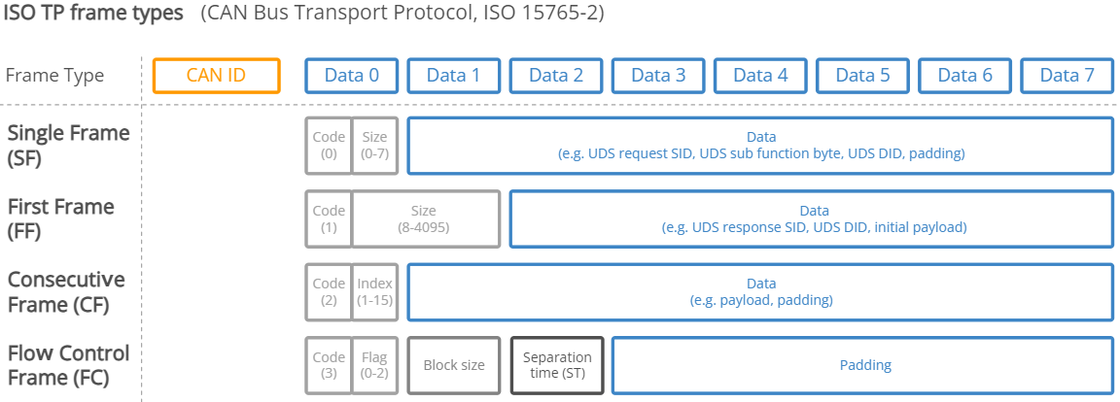
Analyze CAN data in Practical (Case Study 2)
■What are CAN based higher layer protocols?
The ISO defines 4 frame types:
Type | Code | Description
Single frame (SF) | 0 | The single frame transferred contains the complete payload of up to 7 bytes
First frame (FF) | 1 | The first frame of a longer multi-frame message packet, used when more than 7 bytes of data segmented must be communicated. The first frame contains the length of the full packet, along with the initial data.
Consecutive frame (CF) | 2 | A frame containing subsequent data for a multi-frame packet
Flow control frame (FC) | 3 | the response from the receiver, acknowledging a First-frame segment. It lays down the parameters for the transmission of further consecutive frames.
 | 4..15 | Reserved

Slide 24
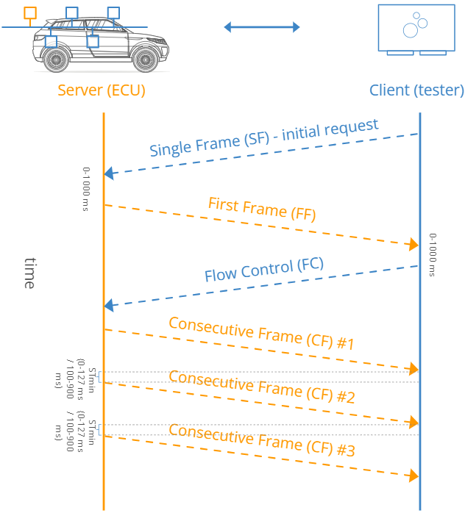
Analyze CAN data in Practical (Case Study 2)
■What are CAN based higher layer protocols?
Multi-frame communication process

Slide 25
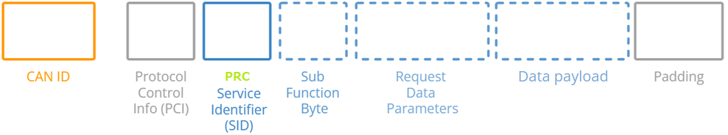
Analyze CAN data in Practical (Case Study 2)
■What are CAN based higher layer protocols?
Request Message – Positive Response
Example: A Positive Response to a service 0x22 (ReadDataByIdentifier) request will contain the response SID 0x62 and the 2-byte DID, followed by the actual data payload for the requested DID
Tool → ECU
Request
$22
✖
A0 01
+ 0x40
ECU → Tool
Positive Response
$62
✖
A0 01
01 23

Slide 26

Analyze CAN data in Practical (Case Study 2)
■What are CAN based higher layer protocols?
Request Message – Negative Response
Example: A Negative Response to a service 0x31 (RoutineControl) request with reason securityAccessDenied (NRC33)
Tool → ECU
Request
0x31
01
A0 01
ECU → Tool
Negative Response
31
33
securityAccessDenied

Slide 27
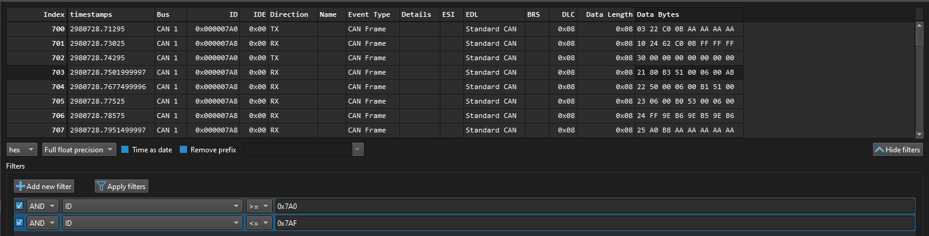
Analyze CAN data in Practical (Case Study 2)
■Example: OBD – UDS frames flow
First we need to know which CAN IDs are for Diagnostic.
In this example, let’s analyze Diagnostic CAN IDs of ECU X:
  Tx (Request from Diag Tool → ECU): 0x7A0
  Rx (Response from ECU → Diag Tool): 0x7A8
Raw data (tool view)

Slide 28
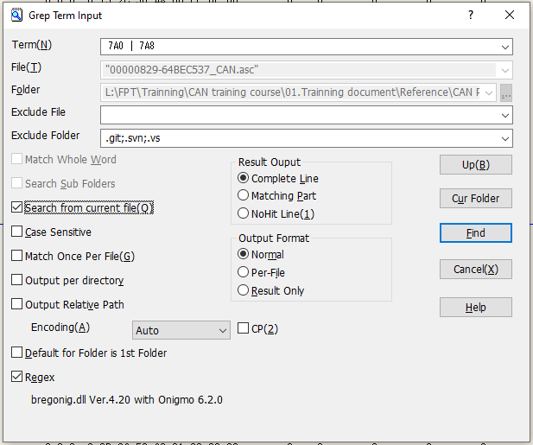
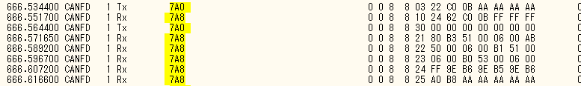
Analyze CAN data in Practical (Case Study 2)
■Example: OBD – UDS frames flow
First we need to know which CAN IDs are for Diagnostic.
In this example, let’s analyze Diagnostic CAN IDs of ECU X:
  Tx (Request from Diag Tool → ECU): 0x7A0
  Rx (Response from ECU → Diag Tool): 0x7A8
Grep in Sakura:
Raw data (.asc view)

Slide 29
Analyze CAN data in Practical (Case Study 2)
■Example: OBD – UDS frames flow
First we need to know which CAN IDs are for Diagnostic.
In this example, let’s analyze Diagnostic CAN IDs of ECU X:
  Tx (Request from Diag Tool → ECU): 0x7A0
  Rx (Response from ECU → Diag Tool): 0x7A8
Raw data (Removed unnecessary information)
ID | Direction | Data Bytes
0x7A0 | Tx | 03 22 C0 0B AA AA AA AA
0x7A8 | Rx | 10 24 62 C0 0B FF FF FF
0x7A0 | Tx | 30 00 00 00 00 00 00 00
0x7A8 | Rx | 21 80 B3 51 00 06 00 AB
0x7A8 | Rx | 22 50 00 06 00 B1 51 00
0x7A8 | Rx | 23 06 00 B0 53 00 06 00
0x7A8 | Rx | 24 FF 9E B6 9E B5 9E B6
0x7A8 | Rx | 25 A0 B8 AA AA AA AA AA

Slide 30
Analyze CAN data in Practical (Case Study 2)
■Example: OBD – UDS frames flow
  Tx (Request from Diag Tool → ECU):
Raw data (Removed unnecessary information)
✖
03
22
C0 0B
ID | Direction | Data Bytes
0x7A0 | Tx | 03 22 C0 0B AA AA AA AA
0x7A8 | Rx | 10 24 62 C0 0B FF FF FF
0x7A0 | Tx | 30 00 00 00 00 00 00 00
0x7A8 | Rx | 21 80 B3 51 00 06 00 AB
0x7A8 | Rx | 22 50 00 06 00 B1 51 00
0x7A8 | Rx | 23 06 00 B0 53 00 06 00
0x7A8 | Rx | 24 FF 9E B6 9E B5 9E B6
0x7A8 | Rx | 25 A0 B8 AA AA AA AA AA
■PCI = 0x03:
  Code = 0: Single Frame
  Size = 3: Payload length = 3 bytes
■SID = 0x22: Read Data By Identifier
■Request Data Parameters = 0x C00B: Identifier = $C00B (Data for information Y)

Slide 31
Analyze CAN data in Practical (Case Study 2)
■Example: OBD – UDS frames flow
  Rx (Response from ECU → Diag Tool):
Raw data (Removed unnecessary information)
✖
10 24
62
C0 0B
FF FF FF
ID | Direction | Data Bytes
0x7A0 | Tx | 03 22 C0 0B AA AA AA AA
0x7A8 | Rx | 10 24 62 C0 0B FF FF FF
0x7A0 | Tx | 30 00 00 00 00 00 00 00
0x7A8 | Rx | 21 80 B3 51 00 06 00 AB
0x7A8 | Rx | 22 50 00 06 00 B1 51 00
0x7A8 | Rx | 23 06 00 B0 53 00 06 00
0x7A8 | Rx | 24 FF 9E B6 9E B5 9E B6
0x7A8 | Rx | 25 A0 B8 AA AA AA AA AA
■PCI = $10 24:
  Code = 1: First Frame
  Size = 0x024: The rest data length to be transmitted = 36 bytes (include PRC SID and Request Data Parameters )
■PRC SID = 0x62: Positive Response for Request 0x22
■Request Data Parameters = 0x C00B: Identifier = $C00B (Data for information Y)
■Initial Data Payload: FF

Slide 32
Analyze CAN data in Practical (Case Study 2)
■Example: OBD – UDS frames flow
  Tx (Request from Diag Tool → ECU):
Raw data (Removed unnecessary information)
✖
✖
✖
30 00 00
00 00 00 00 00
ID | Direction | Data Bytes
0x7A0 | Tx | 03 22 C0 0B AA AA AA AA
0x7A8 | Rx | 10 24 62 C0 0B FF FF FF
0x7A0 | Tx | 30 00 00 00 00 00 00 00
0x7A8 | Rx | 21 80 B3 51 00 06 00 AB
0x7A8 | Rx | 22 50 00 06 00 B1 51 00
0x7A8 | Rx | 23 06 00 B0 53 00 06 00
0x7A8 | Rx | 24 FF 9E B6 9E B5 9E B6
0x7A8 | Rx | 25 A0 B8 AA AA AA AA AA
■Flow Control Frame with the simplest case:
all remaining frames to be sent without delay

Slide 33
Analyze CAN data in Practical (Case Study 2)
■Example: OBD – UDS frames flow
  Rx (Response from ECU → Diag Tool):
Raw data (Removed unnecessary information)
✖
✖
2x
…
AA AA AA AA AA
ID | Direction | Data Bytes
0x7A0 | Tx | 03 22 C0 0B AA AA AA AA
0x7A8 | Rx | 10 24 62 C0 0B FF FF FF
0x7A0 | Tx | 30 00 00 00 00 00 00 00
0x7A8 | Rx | 21 80 B3 51 00 06 00 AB
0x7A8 | Rx | 22 50 00 06 00 B1 51 00
0x7A8 | Rx | 23 06 00 B0 53 00 06 00
0x7A8 | Rx | 24 FF 9E B6 9E B5 9E B6
0x7A8 | Rx | 25 A0 B8 AA AA AA AA AA
■PCI = $2x:
  Code = 2: Consecutive Frame
  Index = 1…5: Sequence of Frames
■In the end, the Data which is response from the ECU (data stored in Identifier $C0 0B) is:
FF FF FF 80 B3 51 00 06 00 AB 50 00 06 00 B1 51 00 06 00 B0 53 00 06 00 FF 9E B6 9E B5 9E B6 A0 B8

Slide 34
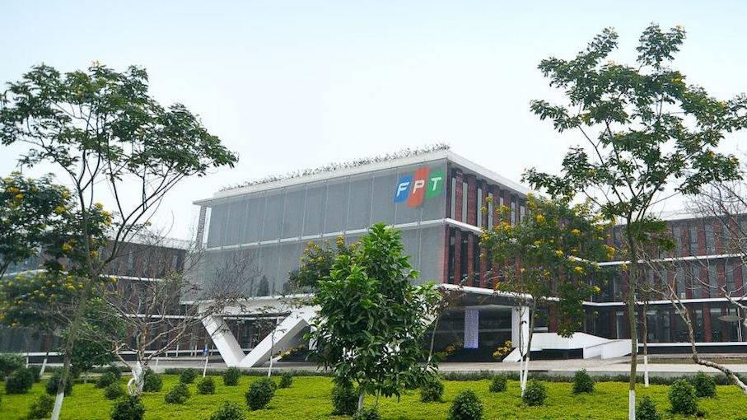


THANK YOU

